Slide 1
BONUS: 156 Editable Icons for Presentations
©Presentation-Process.com

Slide 2





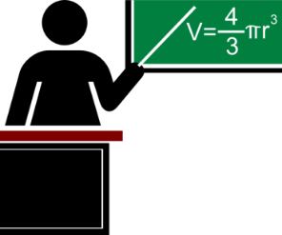
Presentation
Teaching
Speaker
Knowledge
Lecture
Library

Slide 3



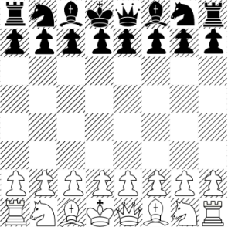


Short term view
Long term view
Vision
Strategy
Roadmap
Schedule

Slide 4






Learn
Think
Remember
Note down
Erase
Publish

Slide 5





Correct
Wrong
Unclear
Thumbs up
Thumbs down
Very Good

Slide 6






Thought
Idea
Good idea
Great idea
Blue sky idea
Recycled idea

Slide 7






Weak Problem
Solution
Problem
Modern solution
Classic solution
System based solution

Slide 8




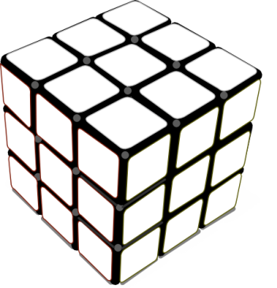

Aim
Direction
Take a chance
Confusion
Disarray
Order

Slide 9






Male staff
Female staff
Executive
Knowledge worker
Relationship
Celebration

Slide 10





Demotivate
Low energy levels
Coffee time
Team
Build connections
Motivate

Slide 11






Stop doing
Do more
Keep doing
Evaluate
Rework
Document

Slide 12






Telephone
Email
Snail mail
Online chat
Voice chat
Video chat

Slide 13






Shopping
E - shopping
Mobile commerce
Find
Pack
Unpack

Slide 14





Turn around time
Process
Database
Target
Approvals
Correspondence

Slide 15






Protect
Firewall
Camera Vigilance / CCTV
Secure
Hack
Unknown

Slide 16

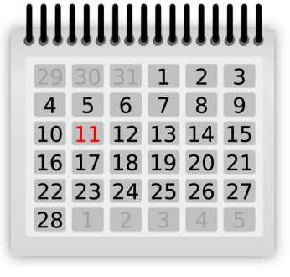




Government
Schedule
Urgent
Legal
Judgment
Arrest

Slide 17





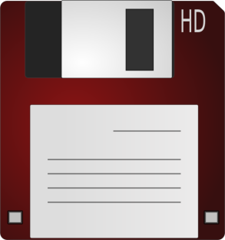
Cursor
Select
Cut
Search
Trash
Save

Slide 18






Laptop
Watch and Print
Print
Time
Computer based
Thumb drive

Slide 19






Home page
Broadcast
Information
Online
World wide Web
USB

Slide 20
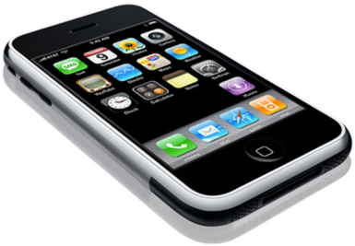





Phone
Browse
Mail
Tweet
Internet news
Voice call

Slide 21






Saving
Male customer
Female customer
Family
Family
Home

Slide 22






Refuel
Repair
Service
Air Travel
Land Transport
Car Travel

Slide 23






Waste
Warning
Recycle
Bio Hazard
Green
Growth

Slide 24






Caution
Watch out
Danger
Immediate threat
Potential threat
Big issue

Slide 25






Diagnose
Inject
Health
First Aid
Medical Kit
Minor injuries

Slide 26






Home
Previous
Play
Pause
Next
Stop

Slide 27





Anchor
Paint
Yin Yang
DNA
Future
Hurry up

Slide 28




Usage Suggestions:
As support for list of points
As support for list of points
Use as is
Add 3D Effect
To represent a process
To represent a process
Use any Background
Change Colors

